Slide 1
360-degree feedback software for the Government of India related News Stories in Regional Media using Artificial Intelligence / Machine Learning
CSE7101- Capstone Project
Review-2
Batch Number: CAI_7
Roll Number | Student Name
20221CAI0010 20221CAI0052 20221CAI0065
CHANDREYI AVIJIT GHOSH
KEERTHANA B
SARAH FAROOQUI
Under the Supervision of,
Dr. Afroz Pasha
Professor
School of Computer Science and Engineering
Presidency University
Name of the Program: CAI
Name of the HoD: Dr. Zafar Ali Khan N
Name of the Program Project Coordinator: Ms. Suma N G
Name of the School Project Coordinators: Dr. Sampath A K , Dr. Geetha A

Slide 2
Content
Problem Statement
Project Overview and Objectives
System Architecture and Workflow
Component Details and Implementation
Output
Timeline of the Project
Git-hub Link
References

Slide 3
Problem Statement Number: PSCS-35
Organization: Ministry of Information and Broadcasting
Category: Software
Objective: Create a 360-degree feedback software for the Government of India to monitor news, analyze public sentiment, and provide actionable insights using AI/ML…
Challenges:
Managing large volumes of multilingual news data
Real-time sentiment analysis and feedback generation
Ensuring accuracy and bias-free insights
Secure handling of sensitive government data
Goal: Enable efficient news monitoring and informed decision-making for the Press Information Bureau (PIB)

Slide 4
Project Overview and Objectives
This project develops a comprehensive media monitoring platform for the Government of India leveraging diverse sources (websites, e-newspapers, and YouTube) using advanced AI/ML. Objectives:
Automate the collection and analysis of government-related news and feedback.
Cover multiple regional languages and media types.
Deliver actionable insights for timely, data-driven government decisions.

Slide 5
System Architecture and Workflow
Comprehensive Monitoring Platform for Government of India integrating multiple media sources
Modular architecture with three main data acquisition channels:
Web Scraper: Automates news portals using React frontend + Python/Node.js backend
OCR Subsystem: Extracts text from e-newspapers (PDF/images) with multi-language support
YouTube Transcript Extractor: Pulls speech-to-text from government/news videos using APIs and ML
Central Analytics Engine:
Consolidates processed data from all channels
Applies data fusion, deduplication, entity recognition, and enrichment
Exposes data to visualization and reporting dashboards
System Design Highlights:
Microservices-based modular communication
Scalable pipeline handling diverse media formats and multiple languages
Real-time and batch data integration enabling timely government decision support

Slide 6
System Architecture and Workflow
Data Source Selection: Automatic channel & website identification based on configured filters and schedules
Extraction & Preprocessing:
Web scraper extracts article content, metadata, and status monitoring via dashboards
OCR processes scanned e-newspapers with noise reduction and script-specific models
YouTube module selects suitable videos, fetches captions or falls back to Whisper ML transcription
Data Unification & Enrichment:
Harmonizes multimodal data with tagging, sentiment analysis, and topic annotation
Removes duplicates and normalizes text across languages for consistent analytics
Visualization & Reporting:
Interactive React-based dashboards for metrics, logs, previews, and trends
Generates actionable insights for government stakeholders across ministries
Supports multilingual search, real-time alerting, and cross-media feedback analysis

Slide 7
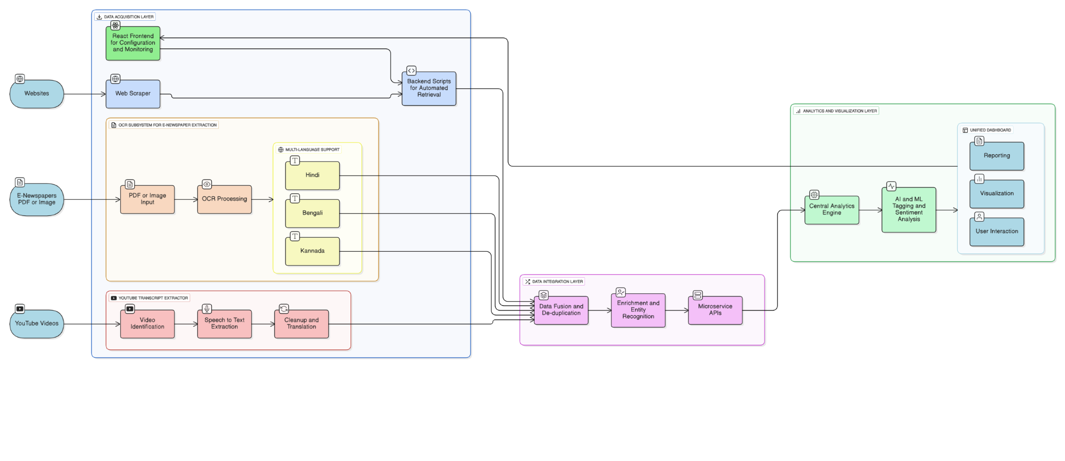
System Architecture and Workflow

Slide 8
Component Details and Implementation
Web Scraper with React Frontend
Implementation: Uses a React-based frontend for configuration (news URLs, filters, languages, schedules) and monitoring scraping jobs.
Backend: Python/Node.js scripts automate retrieval of web news content, parse articles, and push structured text into a central database.
Features: Interactive dashboards for status, logs, and preview of latest results to ensure transparency and usability.

Slide 9
Component Details and Implementation
YouTube Transcript Extraction
Video Selection: Automatically fetches recent, relevant videos from targeted YouTube channels using metadata filters (e.g., duration, live status).
Caption Retrieval: Uses YouTube Transcript API to extract available captions in preferred languages; falls back to downloading audio and transcribing via Whisper ML model if captions are missing.
Text Cleanup: Filters out noisy/live content, concatenates transcript segments, and applies language normalization. Optional translation supports multilingual inputs.
Integration & Annotation: Attaches channel and language metadata; transcripts can be enriched with topic annotations or sentiment tags before storage.
Output Use-Cases: Enables cross-media content analysis, news monitoring, feedback capture, and indexed searchability for government and news media videos.

Slide 10
Component Details and Implementation
OCR for e-Newspaper
Input: Accepts scanned e-newspapers (images/screenshots, PDFs after conversion).
OCR: Uses Tesseract with Hindi, Kannada, Bengali support + preprocessing for noisy text.
Language: Handles Indian scripts with normalization and tuned postprocessing.
Processing: Extracts article text and headlines.
Classification: Keyword-based, multi-label tagging into departments (Health, Finance, International Relations, etc.).
Output: JSON with language, department(s), summary, keyword hits, and OCR text.

Slide 11
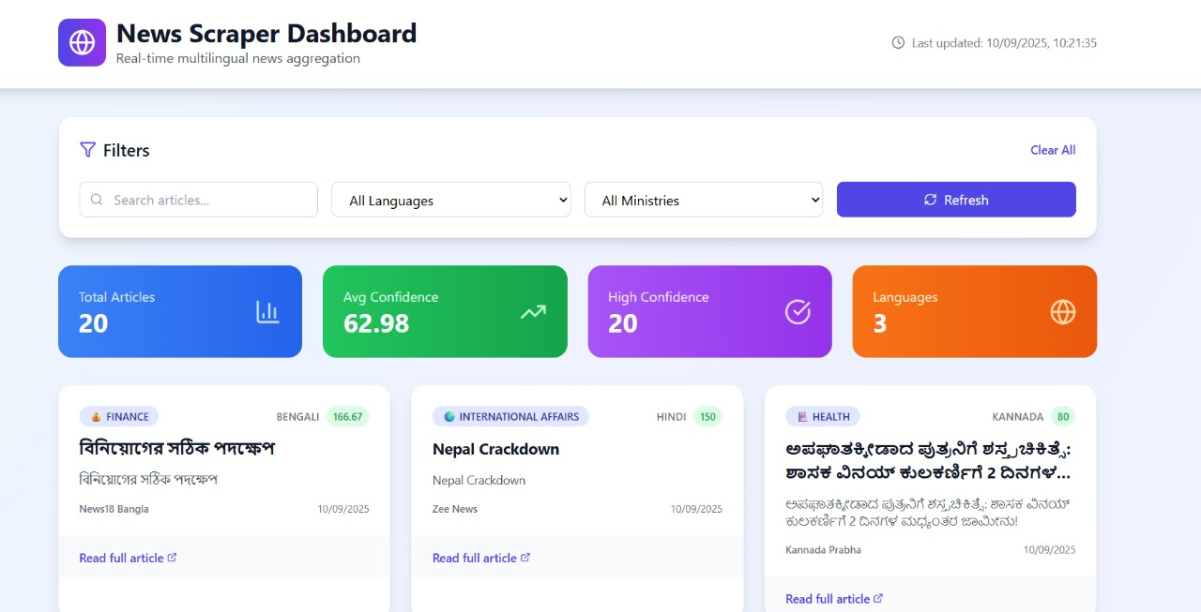
OUTPUT

Slide 12
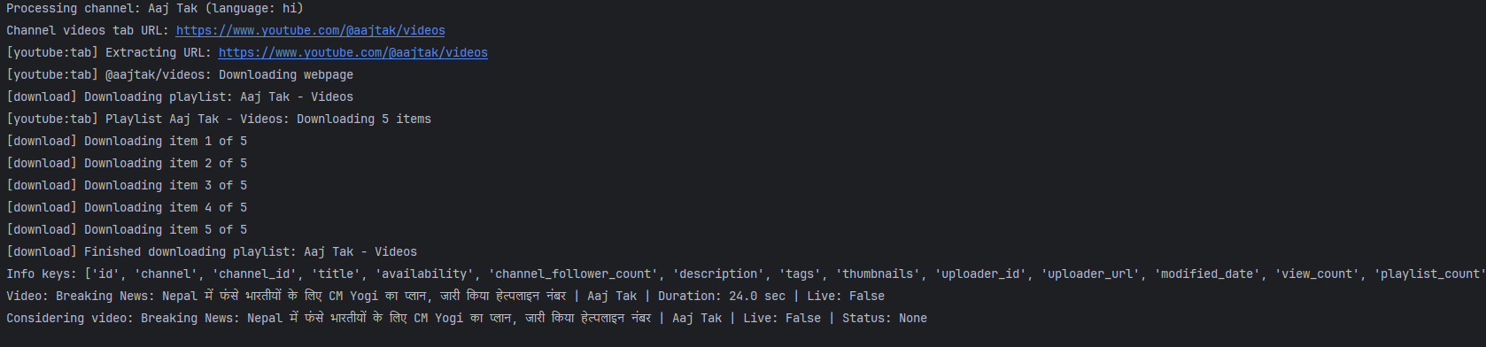
OUTPUT

Slide 13
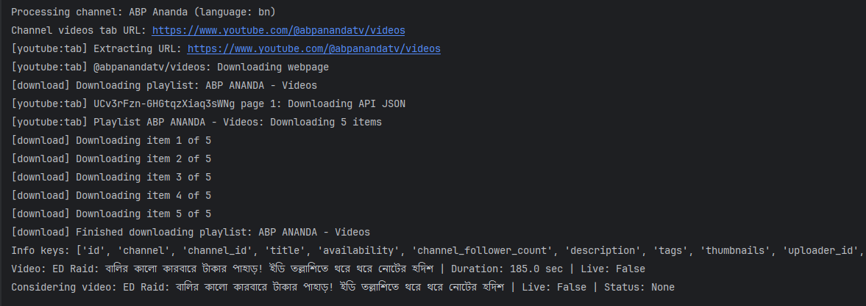
OUTPUT

Slide 14
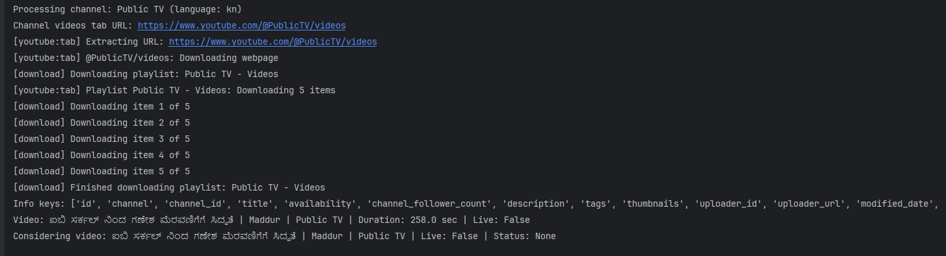
OUTPUT

Slide 15
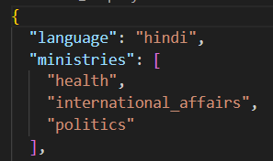
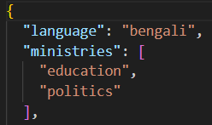
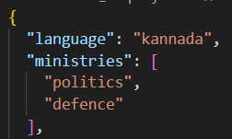
OUTPUT

Slide 16
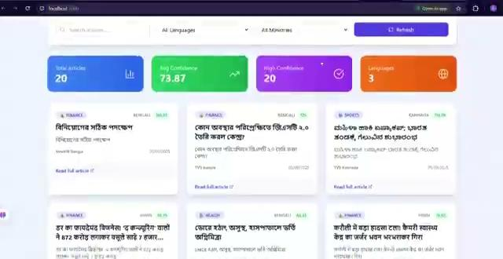
OUTPUT

Slide 17
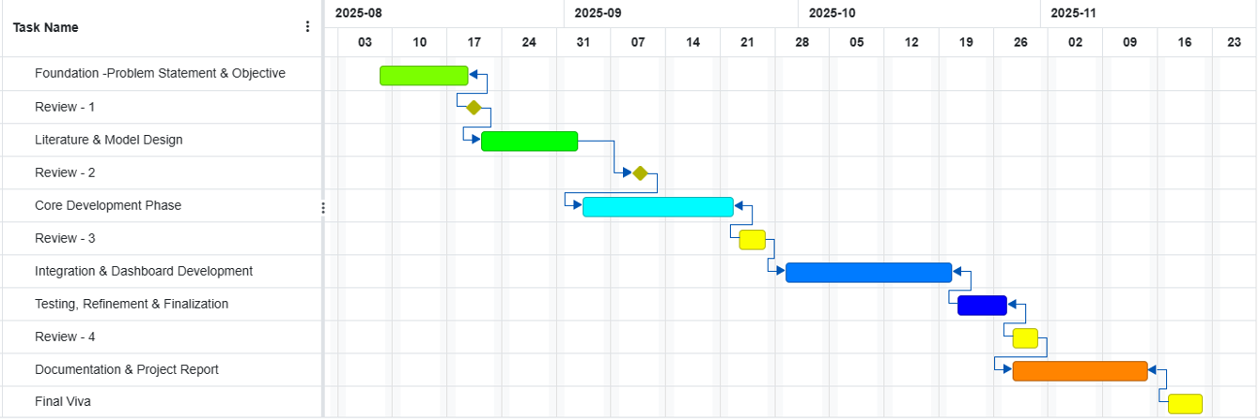
Timeline of the Project (Gantt Chart)

Slide 18
Github Link
The Github link provided should have public access permission.
Github Link

Slide 19
References (IEEE Paper format)
[1] K. S. Kumar, D. S. Rajput, B. S. S. Raj, and R. S. Raj, "360-degree feedback software for the Government Press Information Bureau (PIB) using artificial intelligence and machine learning," *Int. Res. J. Mod. Eng. Technol. Sci.*, vol. 6, no. 5, pp. 714–720, May 2024. [Online]. Available: Link
[2] K. S. Kumar, D. S. Rajput, B. S. S. Raj, and R. S. Raj, "360-degree feedback software for the Government Press Information Bureau (PIB) using artificial intelligence and machine learning," *Res. Gate*, May 2024, doi: 10.13140/RG.2.2.12131.14880. [Online]. Available: Link
[3] Vorecol Team, "The role of artificial intelligence in enhancing 360-degree feedback processes," *Vorecol Blog*, 2024. [Online]. Available: Link
[4] K. S. Kumar, D. S. Rajput, B. S. S. Raj, and R. S. Raj, "360-degree feedback software for the Government Press Information Bureau (PIB) using artificial intelligence and machine learning," *Int. Adv. Res. J. Sci. Eng. Technol.*, vol. 11, no. 4, pp. 714–720, 2024. [Online]. Available:
Link
[5] S. M. Alblwi, A. A. Almazroi, M. Alqarni, H. Alqahtani, and A. Albesher, "A review of 360-degree feedback as a tool of leadership competency development," *Appl. Sci.*, vol. 13, no. 3, p. 1445, Jan. 2023, doi: 10.3390/app13031445. [Online]. Available: Link

Slide 20
References (IEEE Paper format)
[6] D. I. Ivanova and A. V. Sokolov, "360-degree feedback: Automation using natural language processing," in *Proc. CEUR Workshop*, vol. 3159, 2022, pp. 1–8. [Online]. Available: Link
[7] A. V. Sokolov and D. I. Ivanova, "Automation of 360-degree feedback processes in organizations using natural language processing," *Procedia Comput. Sci.*, vol. 178, pp. 350–357, 2020, doi: 10.1016/j.procs.2020.11.037. [Online]. Available: Link
[8] K. S. Kumar, D. S. Rajput, B. S. S. Raj, and R. S. Raj, "360-degree feedback software for the Government Press Information Bureau (PIB) using artificial intelligence and machine learning," *Int. J. Adv. Res. Sci. Commun. Technol.*, vol. 4, no. 5, pp. 714–720, May 2024. [Online]. Available: Link
[9] "Sentiment analysis of tweets in three Indian languages,"
[10] "Sentence opinion mining model for fusing target entities in official government documents,"
[11] "NAAC SSR document," Dr. Babasaheb Ambedkar Marathwada Univ., 2023. [Online]. Available: Link

Slide 21


